Slide 2
I can define matter. I can identify liquids, solids and gases I can name the changes of states of matter
TRACK WITH ME
READ WITH ME
^{I can describe what matter is}
I can identify liquids, solids and gases in everyday situations
I can name the changes of states in an experiment

Slide 3
What is matter.
Matter is everything around you
All matter is made up of tiny particles called atoms
Matter is constantly experiencing both chemical and physical changes.
Mass is the amount of matter in an object

Slide 4
What is matter.
Matter usually exists in one of three states or phases:
solid, liquid, or gas.
The chair you are sitting on is a solid, the water you drink is liquid, and the air you breathe is a gas.
These changes are known as the states of matter.

Slide 5
States of Matter
Solid
A solid is something that we can hold
A solid keeps its shape, unless we cut it or shape it ourselves.
In a solid, all the particles are packed together very tightly.

Slide 6
States of Matter
Liquid
Liquids are runny, they can be poured
The particles are less tightly packed, so they can move about
If poured from one container to another, they will take the shape of their new container

Slide 7
States of Matter
Gas
The particles in gases have lots of room to move
Gases are all around us
They do not have a fixed shape

Slide 8
Changes of State
Provide 5 examples of matter at different stages.
Solid | Liquid | Gas
Chair | Milk | Helium

Slide 9
Changes of State
We can change a solid into a liquid or gas by changing the temperature. This is known as changing its state.
Water is a liquid at room temperature but becomes a solid called ice if it is cooled down.
The same water turns into a gas called water vapour if it is heated up. Changes only happen when the substance reaches a certain temperature.
Water boils at 100 C
Water freezers at 0C

Slide 10
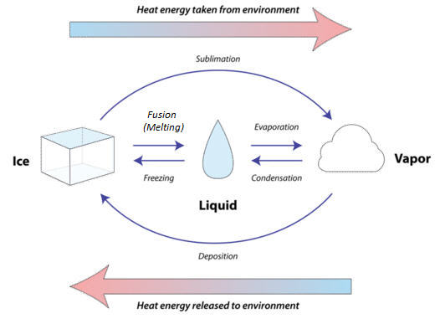
Changes of State
Add the following terms to their correct position in the changing of states diagram above. Freezing, condensation, evaporation, melting, deposition and sublimation

Slide 11
Changes of State
Add the following terms to their correct position in the changing of states diagram above. Freezing, condensation, evaporation, melting, deposition and sublimation

Slide 12
I can state the Law of Conservation of Mass I know the difference between a reversible and irreversible change. I can independently identify a reversible and irreversible change
I can state the Law of Conservation of Mass and analyse what the theory means during a chemical reaction.
I can identify reversible and irreversible changes in chemical reactions.

Slide 13
The Law of Conservation of Mass
In a physical change, no new substance is made, like when water turns to ice; it has just changed state
Physical changes come in many forms.
It can be a change in the shape or appearance of an object, like crumpling a piece of paper, or cutting, bending, or dissolving something.
Physical change, can be reversed
For example, if you dissolve sugar in water you can easily reverse the change by evaporating the water from the solution.
When all the water evaporates, sugar crystals will be left behind.

Slide 14
The Law of Conservation of Mass
In a chemical change, a new substance is made, like when you burn a candle or make a cake.
Anytime a new substance is made, a chemical change takes place.
Usually two or more materials are combined, and a new substance is formed.
When bubbles are formed, or a change in colour or temperature, there is a good chance a chemical change has taken place.
A chemical change can produce amazing explosions, like fireworks. Some chemical changes are a little more difficult to spot, like when a nail rusts.

Slide 15
The Law of Conservation of Mass
The Law of Conservation of Mass states
that Mass cannot be created or destroyed
that mass is conserved in physical and chemical changes.
that mass is neither created nor destroyed during any physical or chemical changes.

Slide 16
The Law of Conservation of Mass
A physical change occurs when the appearance of a substance changes but its chemistry remains the same.
No new substance is formed in a physical change; water moving between states of matter,
A Popsicle melting, and a paper crumbled are examples of physical changes.
A chemical change occurs when bonds are broken between atoms and rearranged into new, entirely

Slide 17


Physical and Chemical Change

Slide 18
Draw this table in your books
Chemical Changes | Physical Changes

Slide 19
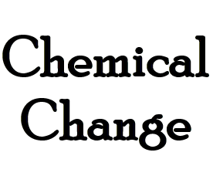


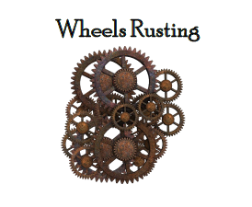
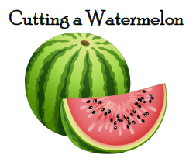
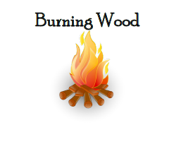
Physical And Chemical Card Sort
Use the cards provided to sort into two categories physical or chemical change.

Slide 20
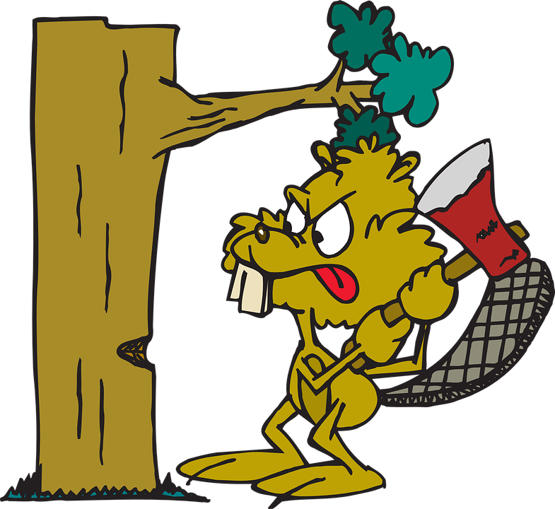
Questions
What criteria did you use to help you sort your cards?
Which cards did you find hard to place?
Using one sentence how do chemical can physical differ?

Slide 21
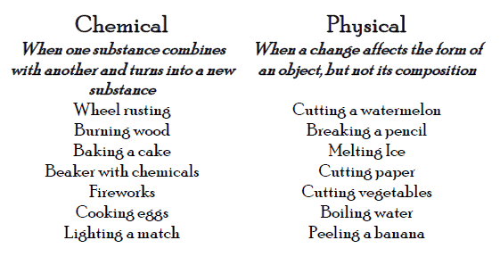
Answers

Slide 22
Reversible and irreversible changes
Some changes in matter can be reversed: the chemicals can be brought back to how they were before.
These are called reversible changes.
Melting is a reversable change.
If a block of chocolate melts, it can be frozen again to make an identical block of chocolate.
Other changers are permanent. It is possible to get back to the starting point; these are called irreversible changes.
Cooking is an irreversible change; it is impossible to turn a cooked egg back to a raw egg.

Slide 23
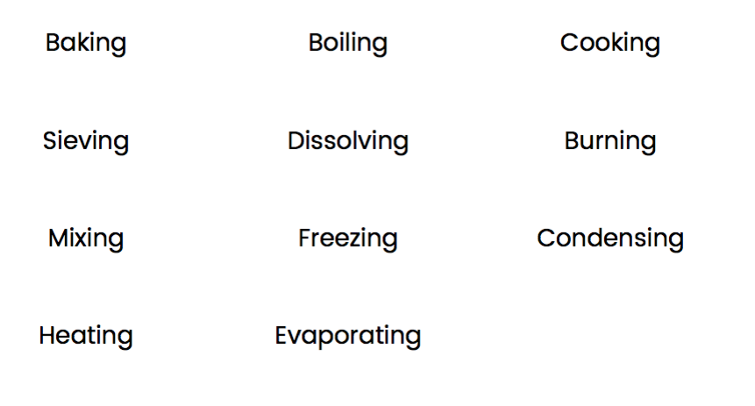
Which process is reversible and which is irreversible?

Slide 24
I can state the Law of Conservation of Mass I know the difference between a reversible and irreversible change. I can independently identify a reversible and irreversible change
I can state the Law of Conservation of Mass and analyse what the theory means during a chemical reaction.
I can identify reversible and irreversible changes in chemical reactions.

